Slide 1
Travis Scott stampede at music festival
Speaker：
ZHANG YUXUAN 21419914 QIU MINGYANG 21460272
CAI JING 21448108 WEN QI 21435014

Slide 2
Outline
01
04
Introduction
Methodology
02
05
Background
Analysis
03
06
Questions
Results and Conclusion

Slide 3
Introduction
Project brief

Slide 4
Introduction
Our project is about Travis Scott, an American rapper and music producer. Travis Scott was thrust into the spotlight after the Nov. 9 stampede. Have things settled down yet? Did fans understand his apology? Our project looked at his Twitter feed, grabbed the data and analyzed it based on social networks and fan bases. Travis Scott analyzed it in combination with his song sales and YouTube views. Our project can take the audience to understand him in a more visual and three-dimensional way.

Slide 5
Background

Slide 6
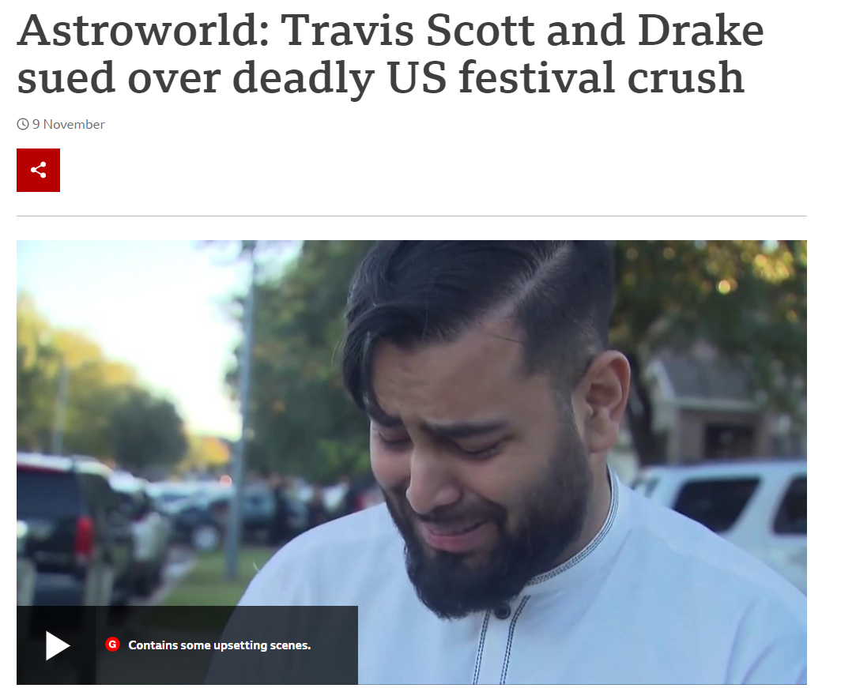
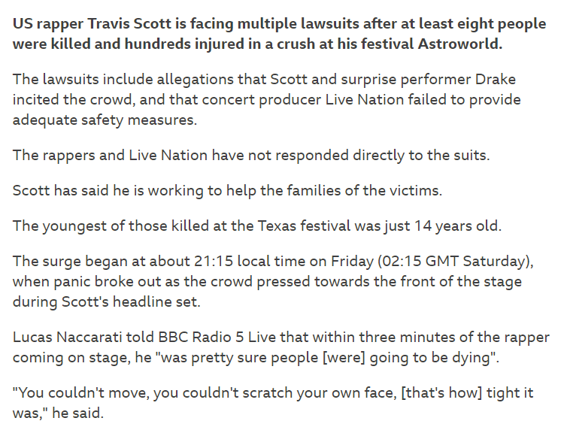
Background

Slide 7
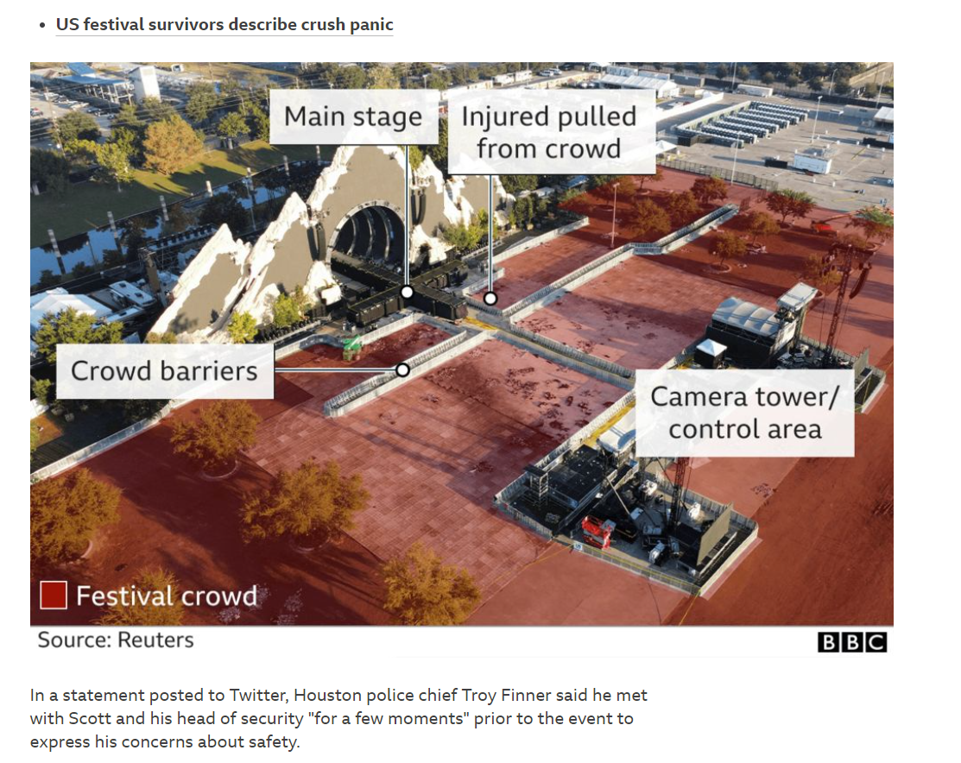
Background

Slide 8
Questions

Slide 9
Hypothesis
Have things settled down yet?
Did fans understand his apology?

Slide 10
Methodology

Slide 11
Methodology
Our project looked at his Twitter feed, grabbed the data and analyzed it based on social networks and fan bases.
Travis Scott analyzed it in combination with his song sales and YouTube views.
Our project can take the audience to understand him in a more visual and three-dimensional way.
We will use planned behavior theory and conduct online experiments on github based platform.

Slide 12
Analysis
Personal information
Awards and nominations
Song

Slide 13
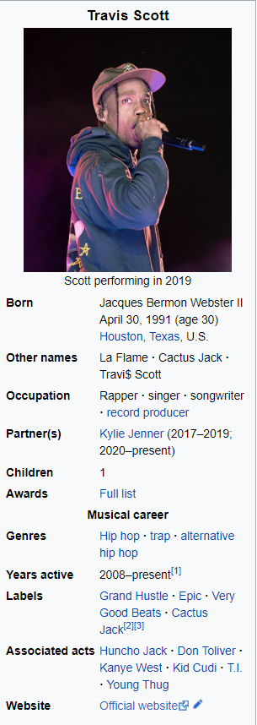
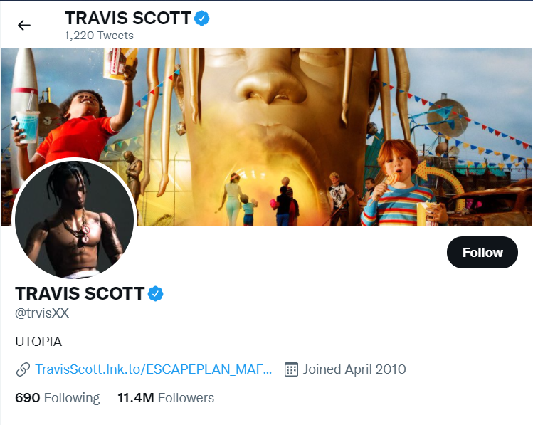
Personal information

Slide 14
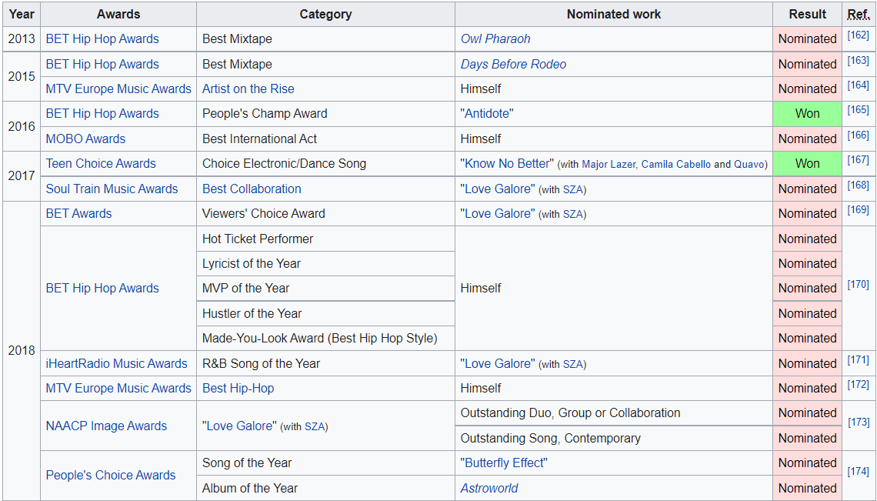
Awards and nominations

Slide 15
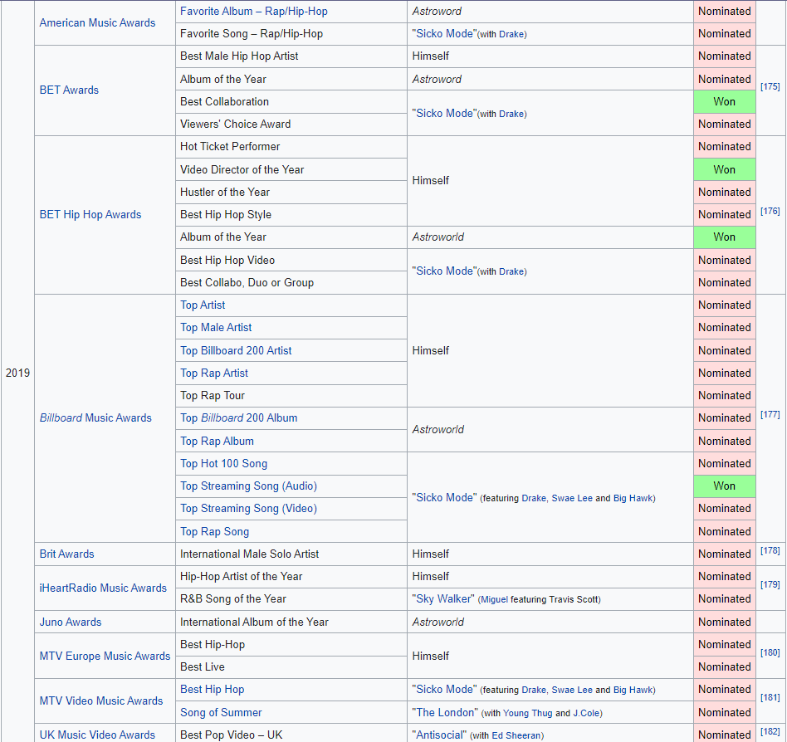
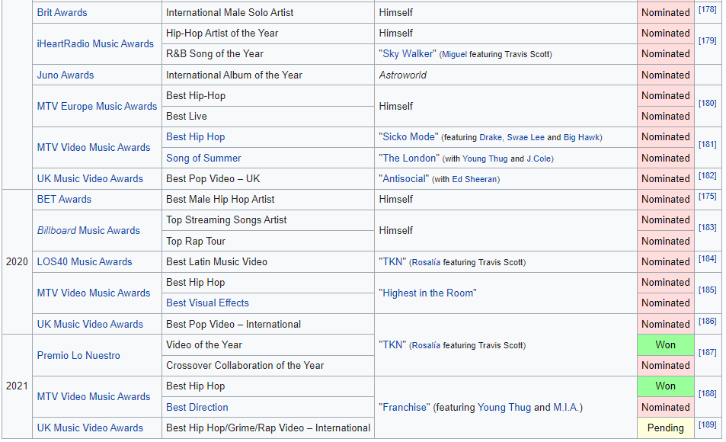
Awards and nominations

Slide 16
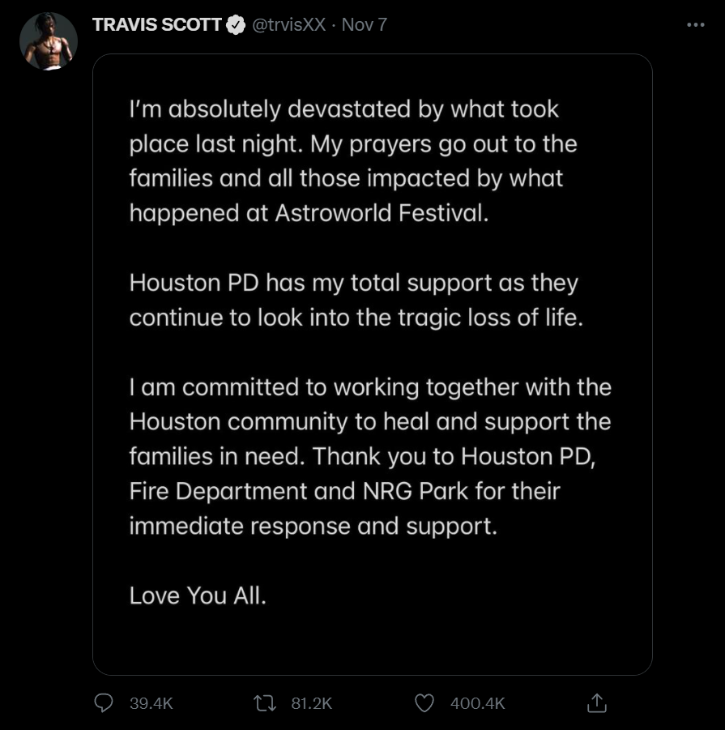
Apologetic statements

Slide 17
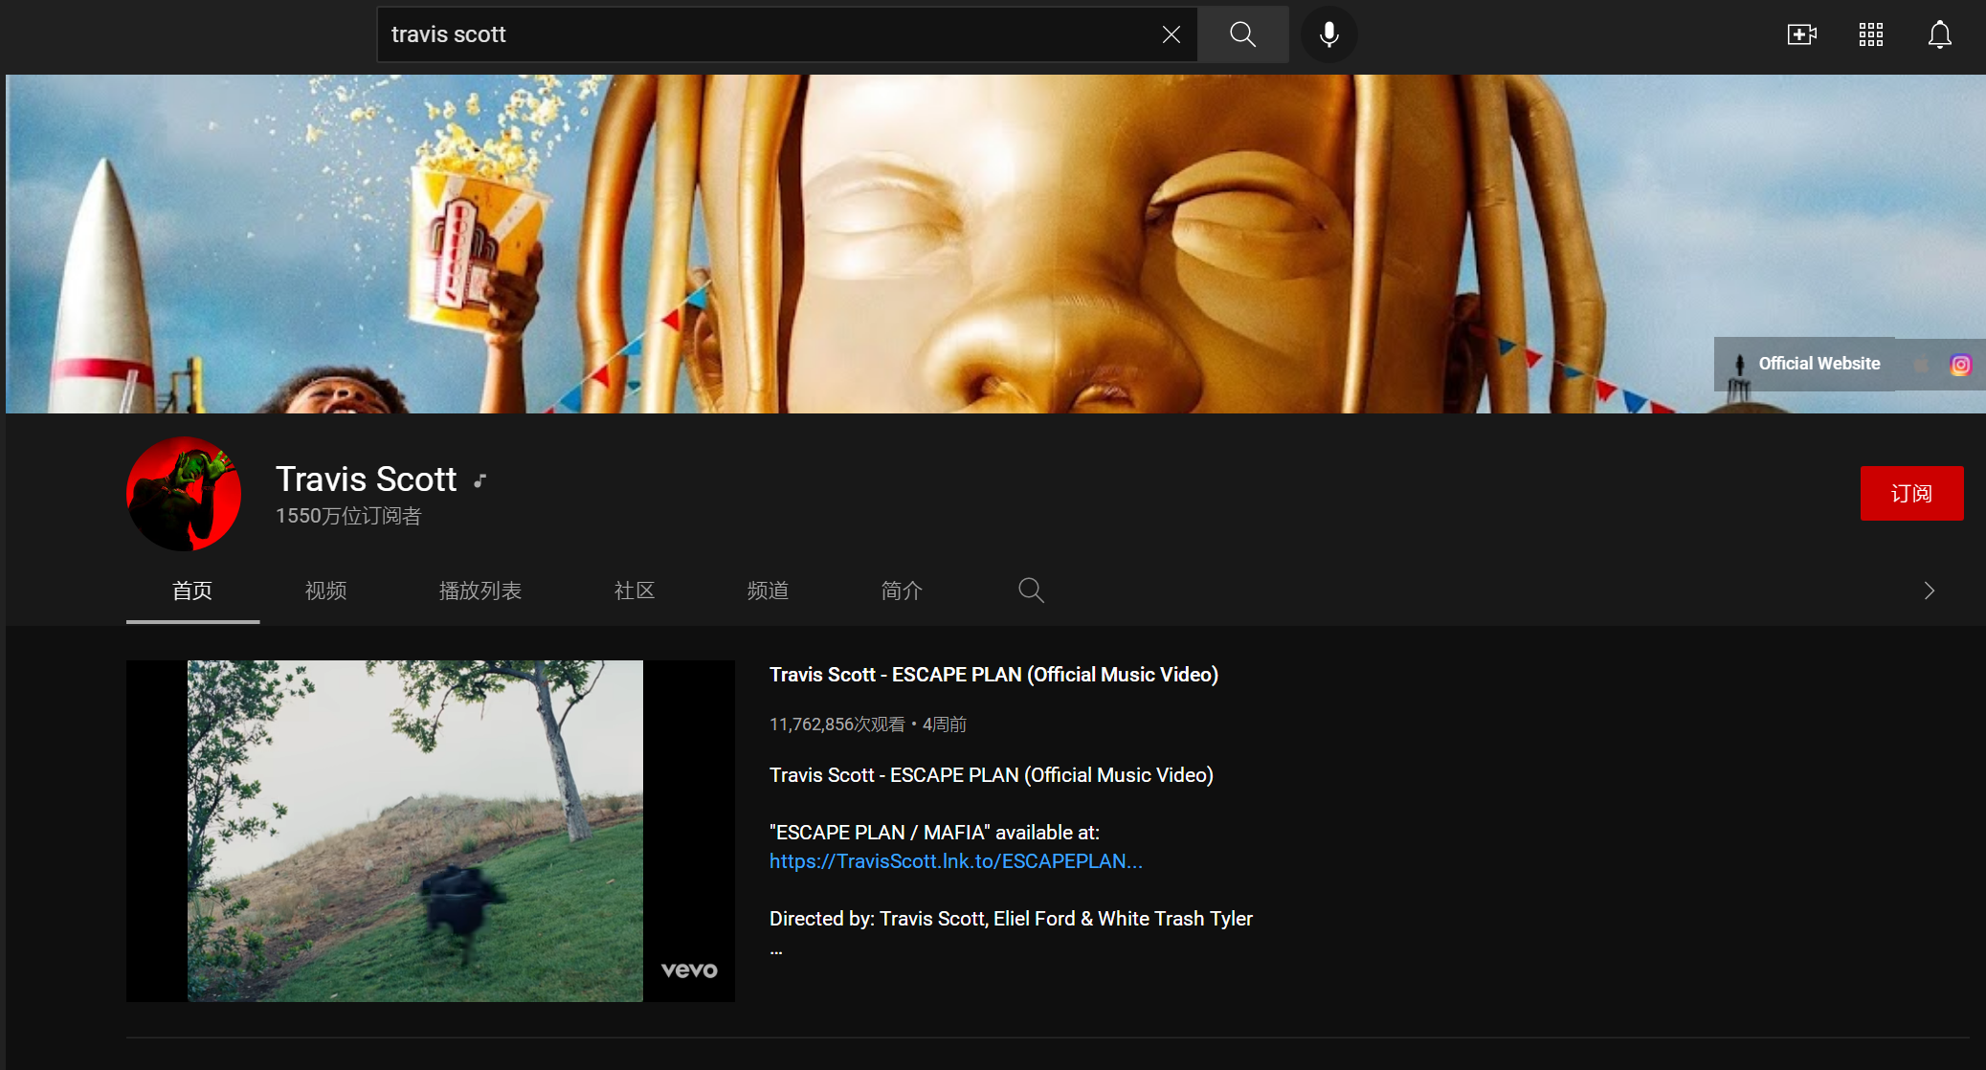
Song

Slide 18
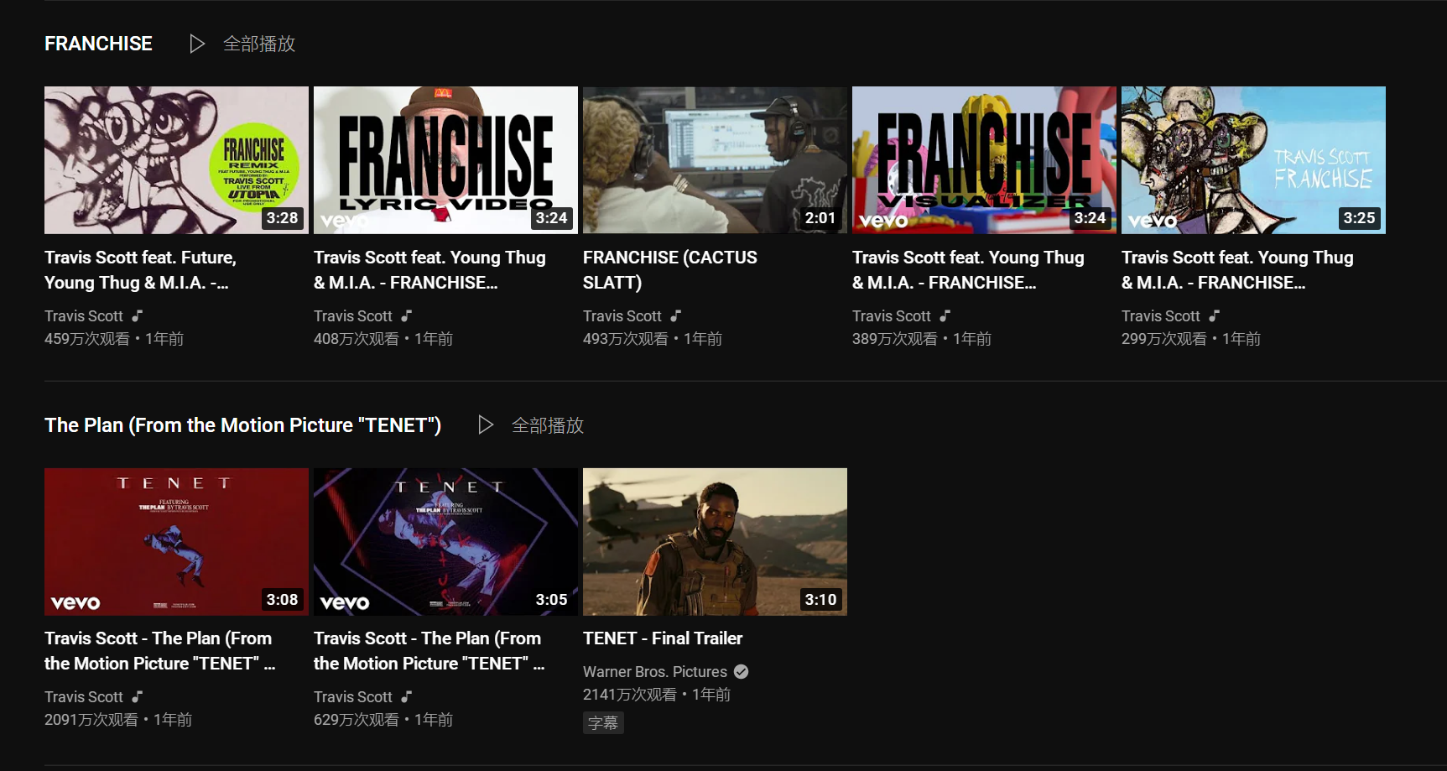
Song

Slide 19
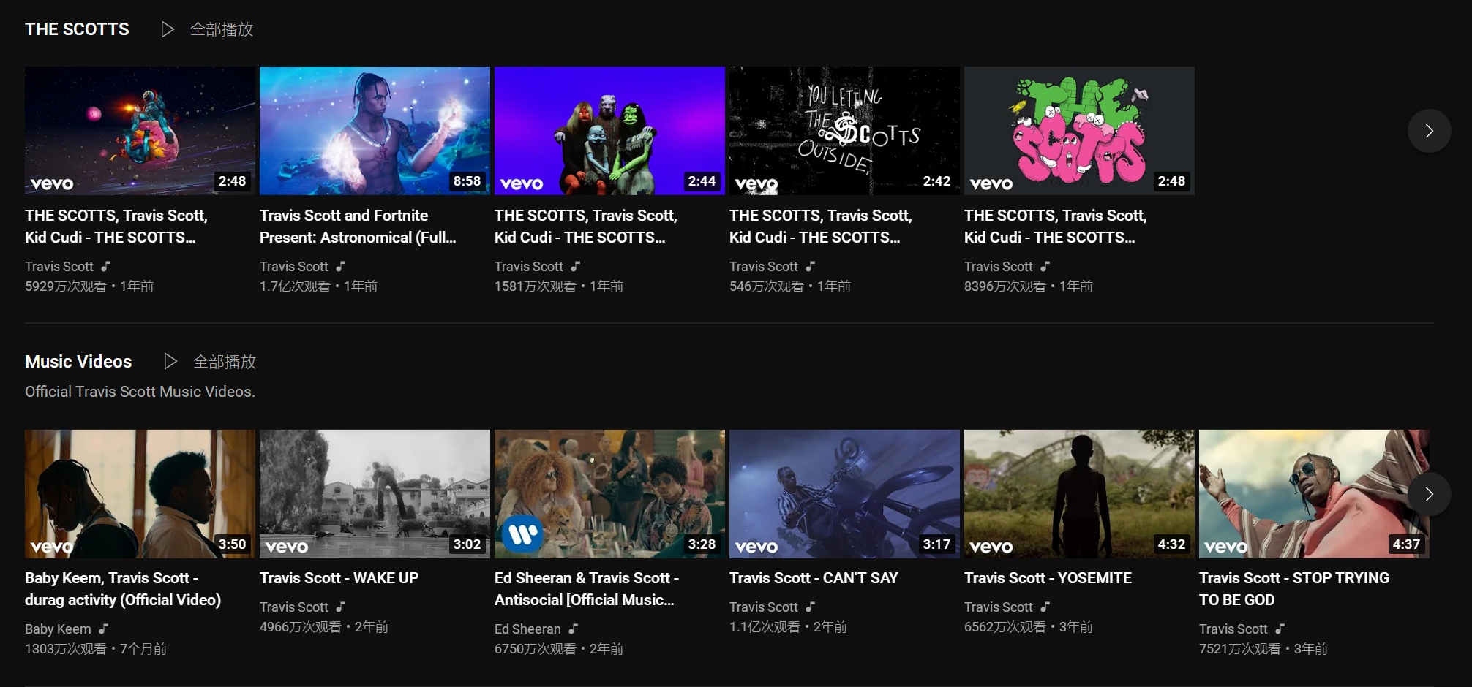
Song

Slide 20
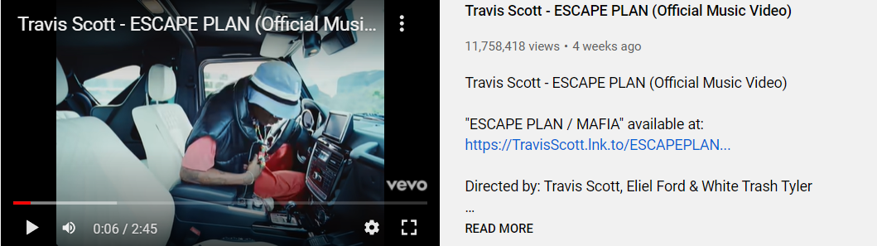
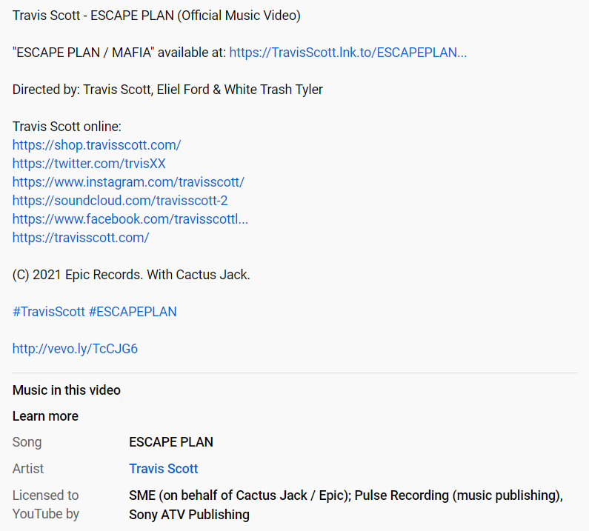
Song

Slide 21
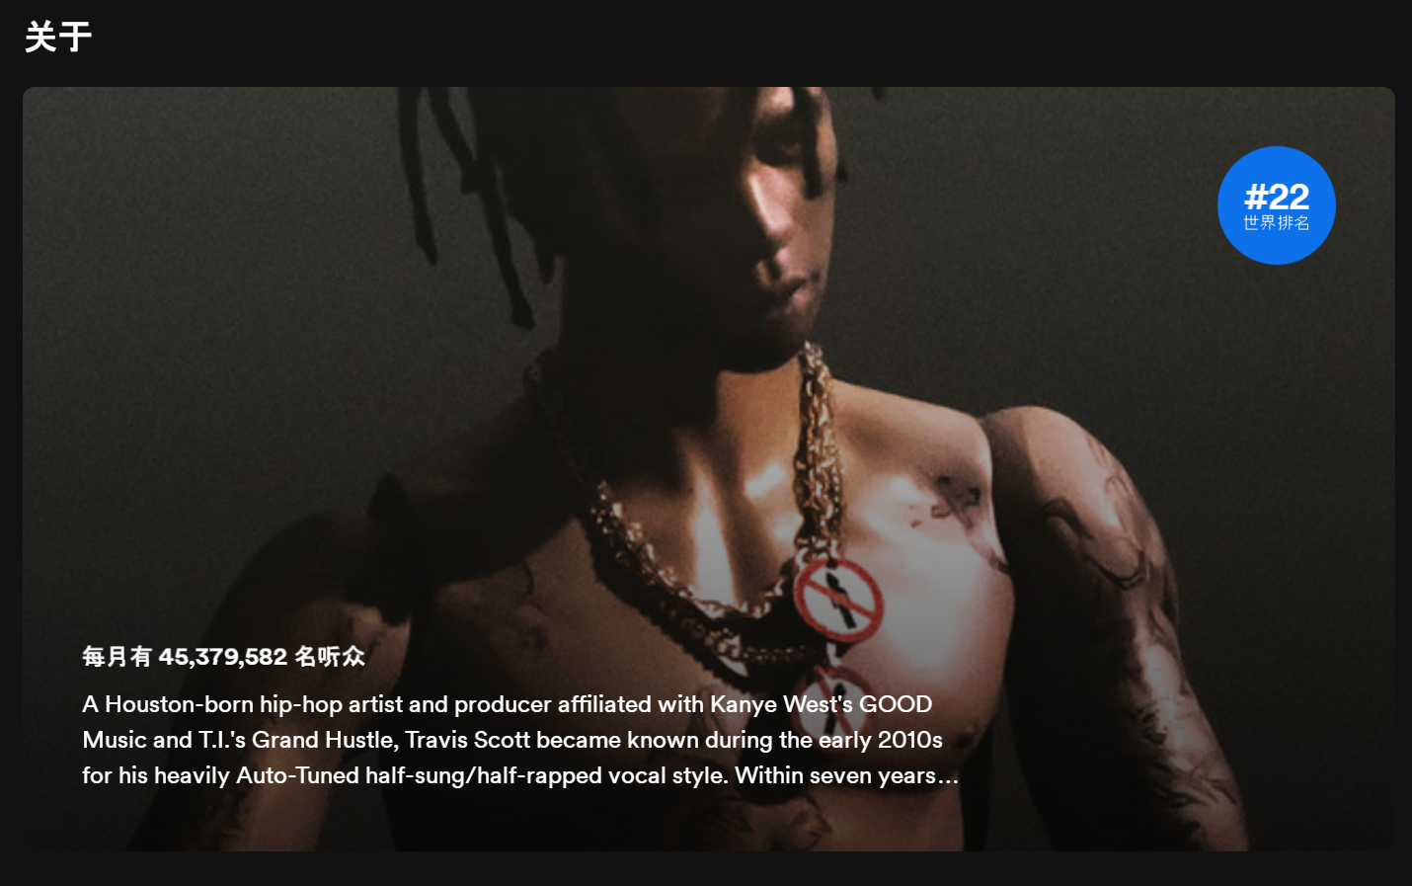
Spotify Monthly Listeners

Slide 22
Results and Conclusion

Slide 23
Results and Conclusion
After preliminary work, we found that more people were confused about why Travis Scott didn't stop the concert when he discovered the stampede.

Slide 24
Thank you for watching!

